Slide 1
Case Study: Rural Women in the U.S. South
Shyronn Jones
Policy Fellow
Positive Women’s Network-USA
www.pwn-usa.org
/pwnusa
@uspwn

Slide 2
Positive Women’s Network-USA (PWN-USA) is a national membership body of women living with HIV (WLHIV); founded and led by WLHIV.
Mission: To prepare and involve women living with HIV, in all our diversity, including gender identity and sexual expression, in all levels of policy and decision-making.
Structure: Board of directors are entirely WLHIV, including women of trans experience. Staff are majority WLHIV and majority women of color.

Slide 3
Our Strategies

Slide 4
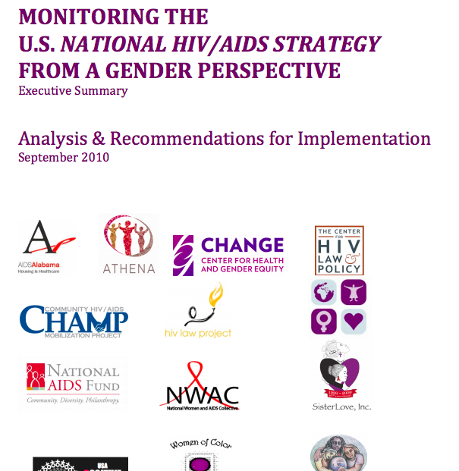

Slide 5
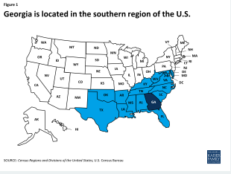
Landscape
Pop: 9.6 million
30% Black (vs 12% of U.S. population)
22% live in poverty (vs 20% nationally)
Severe racial disparities
Home to the Centers for Disease Control and Prevention (CDC)
Georgia (GA) is a southern state in the U.S.

Slide 6
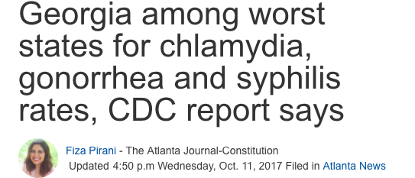
1 in 51 GA residents will be diagnosed with HIV in their lifetimes.
3rd in nation for gonorrhea
4th in nation for primary and secondary syphilis
5th in nation for chlamydia
No Medicaid expansion
600,000 low-income residents would be eligible if expanded

Slide 7
Human Rights Spotlight: HIV Criminalization in GA
GA.CODE ANN. 16-5-60(c)-(d) allows for criminal prosecution based on HIV status. In Georgia a person who knows they are living with HIV is guilty of a felony if they don’t disclose their status before having sex, sharing needles, donating organs or participating in sex work.
HIV criminal laws in Georgia around disclosure and “reckless conduct” were passed in 1988, and were intensified in 2003 with an “ assault with intent” subsection added.
This law has resulted in 571 arrests from 1988 to September 2017, according to state-level criminal history record information analyzed by the Williams Institute. Analyses some disparities in enforcement of the laws based on race, sex, geography, and underlying related offenses, including sew work and suspected sex work.
Research found that HIV-positive Georgians in rural areas were likely to be arrested for an HIV-related crime than those living in urban areas. Black men were likely to be convicted of an HIV-related offense than white men and convictions for HIV arrest were three times likely when there was a concurrent sex work arrest.

Slide 8
AAAQ Framework

Slide 9
Availability
Teen pregnancy rate in GA is higher than national avg (95 per 1000 vs 84 per 1000)
GA HIV epidemic is shifting from urban to rural areas.
Lack of access to condoms, sex ed, sexual health services
96% of GA counties have no abortion providers
56% of GA women live in the 96% of counties that do not have any abortion providers.
24-hour waiting period for abortion.
No public funding for abortion except in cases of life endangerment, rape and incest.
Notes:
https://www.guttmacher.org/fact-sheet/state-facts-about-abortion-georgia
http://www.advocatesforyouth.org/publications/publications-a-z/635-georgias-youth-focus-on-sexual-and-reproductive-health

Slide 10
Accessibility
Results from a community-based participatory research project in 2015 (N=180 WLHIV)
50% of respondents who had missed a medical appointment cited lack of transportation as the reason
24% of respondents who missed filling a prescription for HIV medications in the past year cited lack of transportation as the reason
Notes:
This is data from a survey of 180 WLHIV PWN conducted in 2015. Full report is available at https://www.pwn-usa.org/policy-agenda/women-centered-care/rwp-report/

Slide 11
Accessibility
15% of respondents who missed filling a prescription cited copay cost as the reason
50% of participants who reported needing child care services on site at their medical provider did not receive those services.
Housing instability and housing insecurity are major barriers to accessing health care throughout the US, including in rural areas.
Notes:
This is data from a survey of 180 WLHIV PWN conducted in 2015. Full report is available at https://www.pwn-usa.org/policy-agenda/women-centered-care/rwp-report/

Slide 12
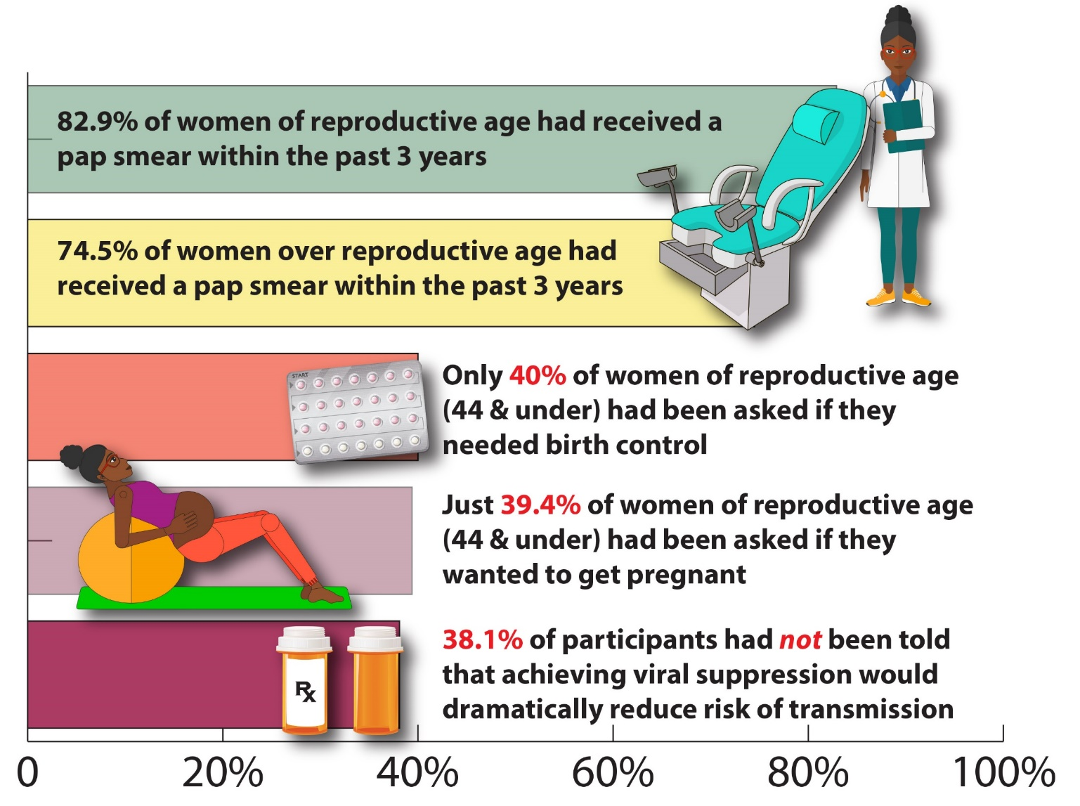
Acceptability
Notes:
This is data from a survey of 180 WLHIV PWN conducted in 2015. Full report is available at https://www.pwn-usa.org/policy-agenda/women-centered-care/rwp-report/

Slide 13
Quality
Culturally relevant care and services needed, especially for Black and Latinx women in the US South
Trans-centered sexual and reproductive health services are lacking
Stigma, especially sexual and reproductive stigma facing WLHIV

Slide 14
Recommendations
Respect full sexual health, rights, and reproductive autonomy of all women living with HIV.
Eliminate stigma, including institutionalized stigma in the form of laws that criminalize HIV exposure, non-disclosure, or transmission.
Expansion of healthcare coverage – Medicaid and single payer - is necessary to address barriers
Support culturally relevant community-based organizations and service delivery providers. Invest in organizations led by the communities they serve.

Slide 15
Thank you
Shyronn Jones
Policy Fellow
Positive Women’s Network-USA
info@iknowawareness.com
Mobile (518) 229-7481
www.pwn-usa.org

