Slide 1
Campaign Planning
For the long term
Presenters:
Waheedah Shabazz-El, PWN-USA
Rebecca Wang, PWN-USA

Slide 2
Session overview:
Session overview:
Review grant objectives
Why campaign
Identifying types of power
SWOT analysis
Allies, opponents
Existing coalitions
Campaign planning in groups
Strategic planning worksheets
Calendaring
Notes:
Set aside time for sustainability on day 3

Slide 3
Why Campaign
A Campaign is a long term strategy which gives you more chances to win.
More chances for your Organizational Considerations.
Recruit more members, retain members, members take on leadership roles, grants become available, form coalitions, go to group.
Implement the 3 Principles of Organizing
Improvement in our lives
Sense of our own power
Alter relations in power

Slide 4
Organizing is Building Power
Organizing is the ability to build power to win campaigns.
Power is the ability to make things happen.
Notes:
-Some are born with power
-Others, who might not have as much power, need
to come together to build collective power in
order to make things happen.

Slide 5
Types of Group Power
Civilian Power:
Ability to support what we value. Ability to form government - a representation of what we value. Ability to conduct boycotts, start petitions & sign on, use of social media, non-violent actions, Also, strike/demonstration power such as the ability to Disrupt Business as Usual, Civil Disobedience, Sit-Ins, Sit-Downs, Die-Ins.
Notes:
You can use your Citizen Power whether or not you choose to disclose your HIV Status
Knowledge plus Action = possible change

Slide 6
Other Types of Group Power
Economic/Spending Power:
Ability to raise money, spend money where it benefits you and your community
Political/Legislative Power:
Ability to win elections or to get something passed by officials. Voter registration drives.
Legal/Regulatory Power:
Ability to sue in court (lawyers on contingency)

Slide 7
Uses of Power
Power generally consists of having:
lots of money
lots of people.
Citizen organizations tend to have people—not money.
Thus our ability to win depends on our being able to do with people what the other side is able to do with money.
So for us, power generally takes one of three forms.

Slide 8
Uses of Power cont.
We can deprive the other side of something it wants: example - a public official is deprived of votes, or a landlord is deprived of rent through a rent strike.
We can give the other side something it wants: example -our members’ testimonies help get a bill passed.
Our organization can elect someone who supports our issues.

Slide 9
Illusions About Power
All too often groups believe that they will win because:
They are morally right.
Truth is on their side.
They have the best information and it is all spelled correctly.
They speak for large numbers of people.
We need all of these in our favor, but sometimes our opponents who have none of them .... win anyway.

Slide 10
Use Tactics to Keep Pressure on the Decision Makers
**A Campaign- You go in knowing you have a long term strategy
-You have minor wins along the way.
-You gain support of others in (other counties) along the way.
-You control the narrative along the way on social media, other interviews, blogs
-Members become point persons for portions of the campaign (build leadership)
-You meet with the governor’s staff along the way.
-
“First they ignore you.
Then they ridicule you.
Then they laugh at you.
Then they fight you.
Then you win!”
Notes:
You go in knowing you have a long term strategy
Tactics:
Phone calls, fax zaps, sign on, press releases, bird dogging

Slide 11
Three (3) Principles Of ORGANIZING
Real Improvements in people’s lives
Gives People a sense of their own power.er
Alters the relations of power
Notes:
1. Tangible improvements
2. When we organize ourselves or campaigns we create work groups. The working groups acted as a breeding grounds for new leaders. The more working groups we form the more leaders we need to bottom line (to be the go to person ) for that group. They have the responsibility of reporting back to the larger group. With that comes a sense of their own power.
3. Your group becomes the “go to” group You are the experts and are called upon for meaningful involvement.
Our ability to keep Pressure” on decision makers.
When we claim to speak for large numbers, we need to show that we can mobilize those people;
Rallies
Demonstrations
Phone and Fax Zaps
Letter-writing campaigns
Petitions
Ballots

Slide 12
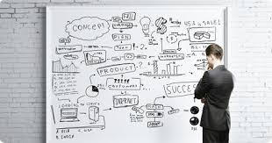
Planning your Campaign

Slide 13
SWOT Analysis: Strengths Weaknesses Opportunities Threats
STRENGTHS What are your de facto strengths? What are you competitive strengths? What are your perceived vs. real strengths? What other internal factors will help you | WEAKNESSES What are your de facto weaknesses? What are your competitive weaknesses? What are your perceived vs. real strengths? What other internal factors will help you?
OPPORTUNITIES What current opportunities do you face? What future opportunities do you face? What opportunities do you face re: opponents? What other external factors will help you? | THREATS What current threats do you face? What future threats do you face? What threats do you face re: opponents? What other external factors will hinder you?
Notes:
Strategy Screen

Slide 14
Allies, opponents
Existing Coalitions
Opponents

Slide 15
Example
Goal 1: Create effective education and communications tools
Goal 2: Build an engaged and empowered grassroots network
Strategy 1: Launch a statewide coalition of supportive organizations and groups
Strategy 2: Develop community leaders to carry the message
Goal 3: Build momentum in the legislature through grassroots advocacy and lobbying
Strategy 1: Move legislation forward and build presence at the capitol
Strategy 2: Educate legislators

Slide 16
Goal 5: Ensure the coalition’s financial viability
Strategy 1: Create a campaign budget
Strategy 2: Identify organizational support within the coalition
Strategy 3: Creating a community of individual investors
Strategy 4: Research and solicit institutional opportunities
Goal 6: Build campaign capacity to guarantee success
Goal 4: Build visibility through community and earned media opportunities
Strategy 1: Create grassroots engagement opportunities
Strategy 2: Create Earned Media Opportunities

Slide 17
What’s Important to Remember

Slide 18
Campaign planning in groups- Exercise
Strategic planning worksheets
Campaign planning in groups- Exercise
Notes:
Who is printing the work sheets … print extras

Slide 19
Talking with decision-makers:
Who do you know? | Position? | Email: | Person to make contact?

Slide 20
Who is going to lead:
Identify at least 2 key persons
Person
Ogranization

Slide 21
Determine goal you want to achieve before starting the campaign
What is the line in the sand when it comes to negotiations?
What is the desicion making process?
⚫Consensus
⚫Discussion until a vote is cast
⚫Chance to slow process down
⚫ Review past decisions

Slide 22
Recognize Your Political Reality: Example
Governor
Nikki R Haley (R)
SC Senate
28 Republicans
18 Democrats
SC House
80 Republicans
44 Democrats

Slide 23
Calendaring
Laying out all the upcoming Community Trainings
Team Meetings
Travel
Meetings with collaborators and other potential partners.
Notes:
Need Butcher Paper around the Room Or rolled out onto a Table. Participants gather at the wall or around the table …….placing important dates and tasks month by month onto the calendar

Slide 24
Commitments- [Insert Campaign Lead(s)]
Review Calendar/ deliverables
Who is responsible for which parts
-
-
-
-
-
-
-

Slide 25
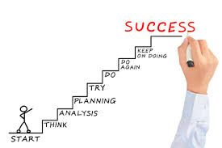

Slide 26
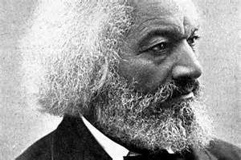
Why Campaign Why don’t they just give us want?
Power concedes nothing without a demand.
"If there is no struggle there is no progress. Those who profess to favor freedom and yet depreciate agitation…want crops without plowing up the ground, they want rain without thunder and lightening. They want the ocean without the awful roar of its many waters
"This struggle may be a moral one, or it may be a physical one, and it may be both moral and physical, but it must be a struggle. Power concedes nothing without a demand. It never did and it never will.
Frederick Douglass-

Slide 27
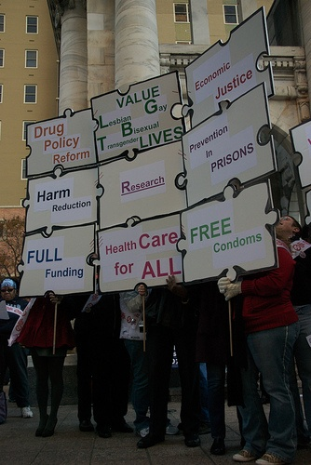
“Half your rights haven’t been written yet because you have not been there to demand them.”
The late, John Horace Bell, Act Up Philadelphia

