Slide 1
National Women and Girls HIV/AIDS Awareness Day Demand Health Care for All- Be a #HealthCareVoter
March 5th, 2020
Notes:
Barb

Slide 2
Logistics
This webinar is being recorded and on Facebook live
Everyone on the webinar will be in attendee mode, your phone will be muted
Feel free to ask questions in the Q and A box or raise your hand to ask a question yourself.
We will have time for questions and answers through out.
Notes:
Barb

Slide 3
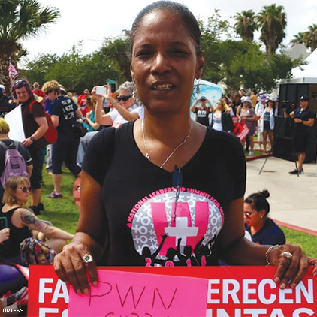
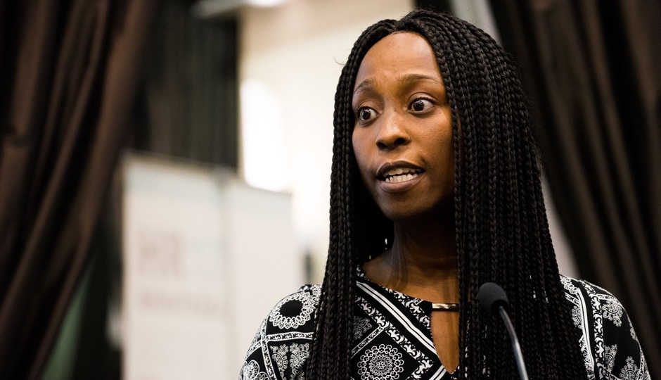
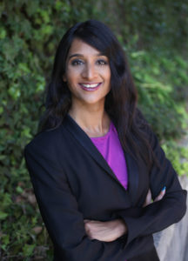
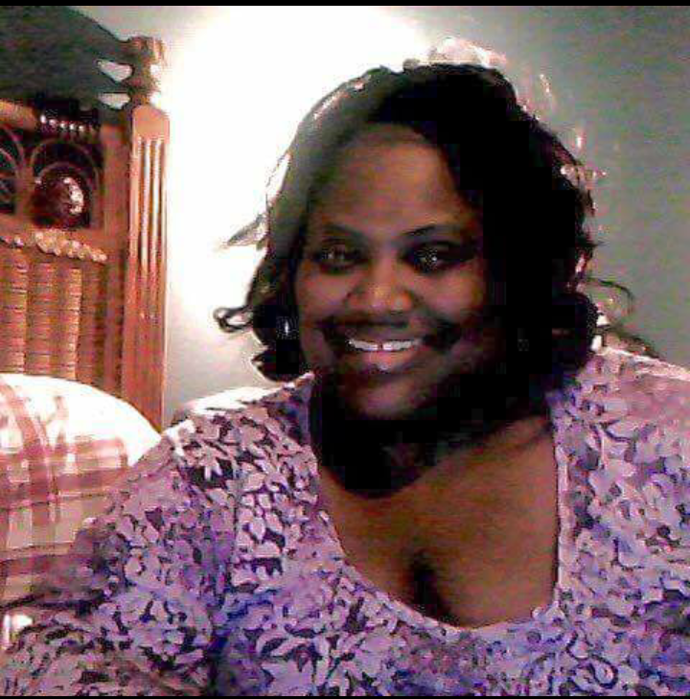
Presenters
Tana Pradia
PWN USA Board Member/ PWN GHA
She/her
Roxanna Glapion
PWN DFW
She/her
Tiommi Luckett
PWN USA Communication and Training Assistant
She/her
Naina Khanna
PWN USA Executive Director
She/her
Barb Cardell
PWN USA Training Director
They/them
Notes:
Barb

Slide 4
Agenda
Welcome and Introductions
National Women and Girls HIV/AIDS Awareness Day
Importance of Health Care
How Do We Talk About Universal Health Care?
Being a Healthcare Voter in 2020
Discussion
Notes:
Tiommi

Slide 5
About Positive Women’s Network-USA
Mission:
To prepare and involve women and people of trans experience living with HIV, in all levels of policy and decision-making.
www.pwn-usa.org
Notes:
Tiommi
As we feel our strength and recognize our worth as women we seize and create opportunities for ourselves and for the upliftment of all women. We mobilize to challenge systems and governments that could not, would not or that simply were not responding to our needs as women. We educate ourselves; we fight for our own causes: We build coalitions that strengthen our positions.
We understood that we were not in this fight alone. None of us were fighting alone.
In 2008, 25 WLHIV came 18 to 73, in all our intersectionality
with several transgender and gender non-conforming folks

Slide 6
What We Do
Build leadership
Analyze and advocate on issues impacting people with HIV
Organize and mobilize
Change the story and who's telling it
Our work is grounded in racial, gender, and economic justice
Notes:
Tiommi

Slide 7
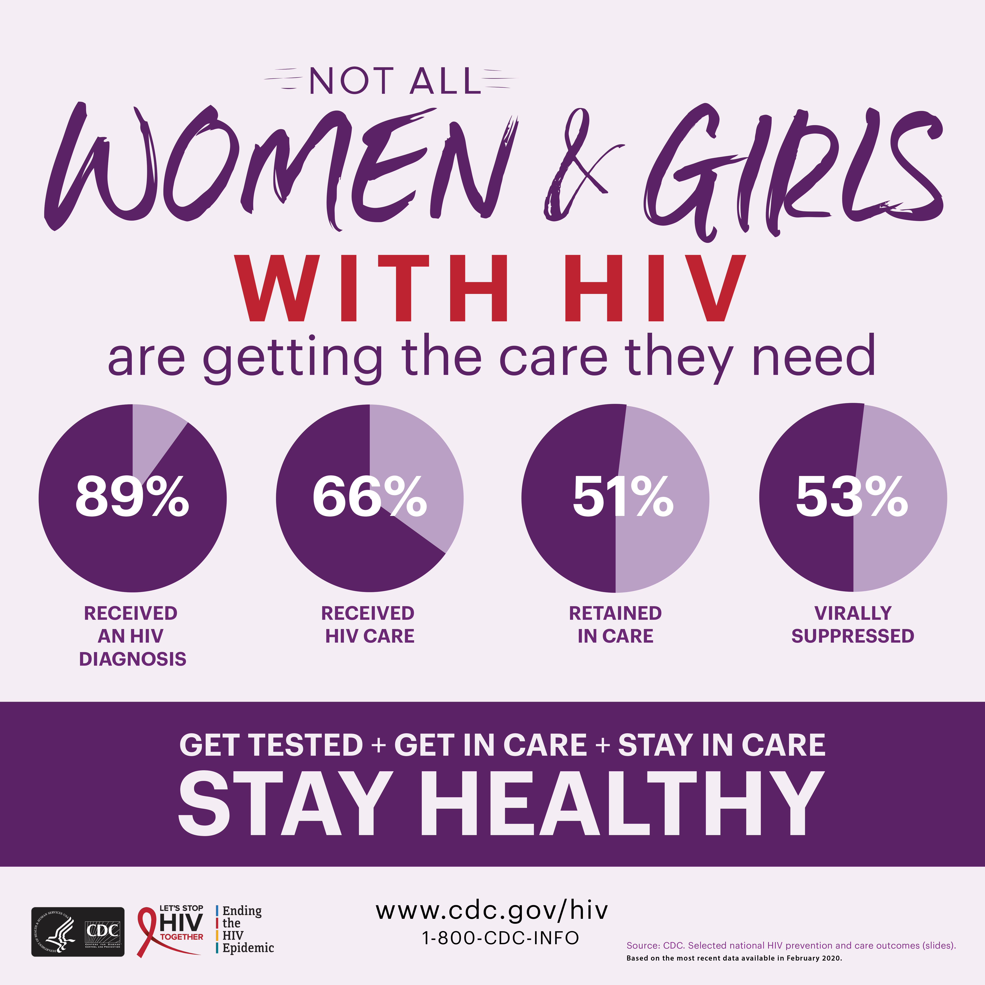
National Women and Girls HIV/AIDS Awareness Day
Notes:
Barb
Background and NWGHAAD
Every year on March 10 — and throughout the month of March — local, state, federal, and national organizations come together to shed light on the impact of HIV and AIDS on women and girls and show support for those at risk of and living with HIV. This year marks the 15th annual observance of National Women and Girls HIV/AIDS Awareness Day (NWGHAAD).
We've made tremendous progress against HIV and AIDS in the U.S., but women remain vulnerable to infection — especially black or African-American and Hispanic women. Any woman who has sex can get HIV, regardless of race, ethnicity, age, or sexual orientation. Today, nearly 1 million people in the U.S. are diagnosed with HIV, and nearly 1 in 4 of them are women.
The 2020 NWGHAAD theme, "HIV Prevention Starts With Me: Ending the HIV Epidemic Together," emphasizes the role everyone plays in HIV prevention—community organizations, health care professionals, and women and men, including those living with HIV. There are steps you can take to protect yourself, your partner, your family, and your neighbors.
To learn more, visit What every woman needs to know about HIV, What every girl needs to know about HIV, or the National Women and Girls HIV/AIDS Awareness Day fact sheet.

Slide 8
Why is Health Care Important ?
Notes:
Both providing care to Healthcare providers, medications and tests when you are sick
Preventative care and building trusted relationships with medical providers as well as having someone who knows us and has a good understanding of who we are, so it's a holistic approach.

Slide 9
History of Health Care in the United States
1920 and before
Great Depression
Medicare/Medicaid
Social Security
ACA
Now ???
Notes:
https://www.kff.org/wp-content/uploads/2011/03/5-02-13-history-of-health-reform.pdf
https://www.griffinbenefits.com/employeebenefitsblog/history-of-healthcare

Slide 10
What we deserve
Affordable Care
Comprehensive care
High quality
Can see a Dr or other care provider
No Discrimination
Total wrap around care

Slide 11
Notes:
Right now in the US, we haven’t yet achieved PWN’s vision. We are the only industrialized nation without universal healthcare. We don’t even really have a health care system – we have health care systems.
Health care coverage in the U.S. is fragmented & impressively complex, with multiple payers -- a number of private and public sources -- and wide gaps in insured rates across the U.S. population. A majority of people are covered through private insurance, which can be for profit or non-profit. Private plans are mostly regulated on the state level so oversight, protections, and requirements can vary depending on where you live – here you can think employee-sponsored plans, individually-bought plans, supplemental plans for people on public insurance, or plans through the ACA marketplace (many of which are also subsidized by the federal government). For public coverage, there’s Medicare, Medicaid, CHIP, Veterans Affairs, more. All of these overlapping, crisscrossing systems create huge gaps for people to tall through – and they do. We have about 27.9 million uninsured people (up 500,000 since 2017).
The Affordable Care Act did expanded access to care for women living with HIV by reducing discrimination, improving the quality and consistency of care, and by reducing financial barriers to health care.
But there are some real limitations. 14 states, most of which are in the US South, have refused to expand coverage to more people under their state Medicaid programs. And generally speaking, Southern states are where we continue to see stark racial, economic and health inequities, and where nearly half of WLHIV in the US reside. The law provides no coverage for undocumented immigrants, limits coverage for other immigrants, and maintains the federal ban on abortion coverage. As we speak, the Courts are debating the constitutionality of the ACA. The administration is encouraging states to apply to make their Medicaid programs less comprehensive, allow more discrimination, and cover less people. The administration is making it more complex for private plans to cover abortion, and kicking comprehensive reproductive health care providers off of public programs.
This isn’t normal, and this isn’t necessary. Basically we’re going to compare the U.S. to other countries with an advances health care system to see how we stack up
Source:
Kaiser Family Foundation, “Key Facts about the Uninsured Population,” December 2019, https://www.kff.org/uninsured/issue-brief/key-facts-about-the-uninsured-population/
Quartz, ”The History of why the US is the only rich country without universal healthcare,” July 2017, https://qz.com/1022831/why-doesnt-the-united-states-have-universal-health-care/
The Commonwealth Fund, International Health Care System Profiles, ”The U.S. Health care system,” n.d. https://international.commonwealthfund.org/countries/united_states/

Slide 12
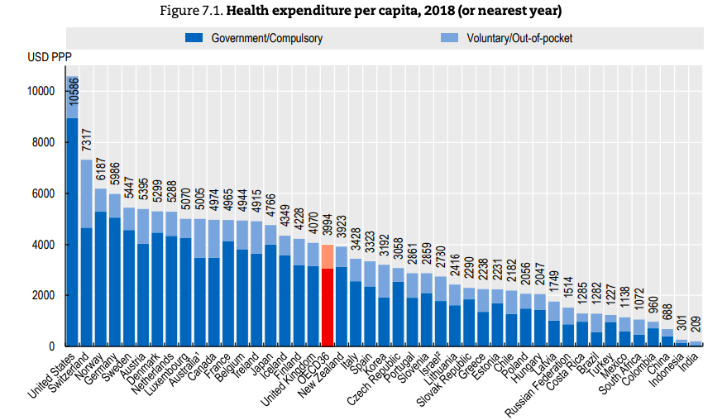
We are paying the most…
Notes:
The United States spent more per person on health care than all other countries by a considerable margin, close to triple the OECD average
The U.S. spends the MOST on drugs, more than double of the the average of similar countries.

Slide 13
We are paying the most…
and getting less…
Notes:
People in the U.S. have the SECOND LOWEST likelihood of seeing a doctor when they need one.
The United States the worst avoidable mortality rates considering how much we spend on health care
We have one of the highest maternal mortality rates of industrialized nations, and the rate is rising in the U.S. as it declines everywhere else
And despite spending the most, the U.S. has one of the LOWEST percentages of people with health care coverage.

Slide 15
“Private health insurance is a defective product, akin to an umbrella that melts in the rain.”
Dr. David Himmelstein, the lead author of Consumer Bankruptcy Project (CBP) study
Notes:
A study last year found that 2 out of every 3 people who file for bankruptcy cite medical reasons – either linked to the illness & time off work or the medical bills themselves.
“Unless you’re Bill Gates, you’re just one serious illness away from bankruptcy. For middle-class Americans, health insurance offers little protection. Most of us have policies with so many loopholes, copayments and deductibles that illness can put you in the poorhouse. And even the best job-based health insurance often vanishes when prolonged illness causes job loss – just when families need it most. Private health insurance is a defective product, akin to an umbrella that melts in the rain.”
Another 2019 study found that about one in every four dollars spent on healthcare in the U.S. is wasted. At least $760 billion per year. That’s comparable to government spending on Medicare and exceeds national military spending, as well as total primary and secondary education spending. The biggest source of waste: Administrative complexity (time and resources devoted to billing, coding, and reporting to insurers and public programs.). Ultimately, the report confirms that not only does the U.S. spend more on healthcare than any other country; it also wastes more than any other country.
Source
Physicians for a National Health Program, “New Medical Bankruptcy Study: Two-Thirds of Filers Cite Illness and Medical Bills as Contributors to Financial Ruin,” Common Dreams, February 2019, https://www.commondreams.org/newswire/2019/02/07/new-medical-bankruptcy-study-two-thirds-filers-cite-illness-and-medical-bills-0
Austin Frakt, “The Huge Waste in the U.S. System, New York Times, October 2019, https://www.nytimes.com/2019/10/07/upshot/health-care-waste-study.html

Slide 16
Getting to Universal Health Care
 | Regulated System | Two-Tier System | Single Payer
What it is? | Government regulates the private health care market. People are required to buy some level of coverage (with exceptions), e.g. individual mandate. | Mixed public and private insurance. Government finances core set of services. People buy additional private insurance | A single public or quasi-public authority – generally the government – finances health care
Who is covered? | Everyone who is required to have insurance, unless they qualify for an exception | All residents covered for a wide range of services with possible cost sharing; private insurance fills the gaps | All residents covered for a core set of benefits, e.g. primary care, annual screening, medically necessary services, w/o cost sharing
Who is delivering care? | Services are delivered through private sector with government regulation, for example defining benefits or cost-sharing limits. | Services are delivered through public and private sector. | Services can be delivered exclusively through public sector or with some contracted private entities
Example | Netherlands | Australia | United Kingdom
Learn more at PWN USA Policy 101 Webinar on Universal Health Care
https://youtu.be/m9dA2_wt6w4
Notes:
There are many ways to get to Universal Health Care which can take many different forms.
If you would like to know more, check out the PWN USA Policy 101 webinar

Slide 17
https://www.pwn-usa.org/wp-content/uploads/2018/07/Universal-Health-Care-PDF.pdf
Notes:
PWN USA Universal Health Care Fact sheet

Slide 18
Impact on Women Living with HIV
Stigma in Medical Settings
Later diagnosis
Complex medical care
Choosing between family necessities and medical care
Notes:
Impacts on WLHIV who don’t have access to affordable, comprehensive , high quality healthcare that works for us.

Slide 19
Moving from Your Brain to your Heart
Notes:
Tiommi
Oftentimes as advocates, we are worried to talk about complicated issues because we're worried that we are going to get the facts wrong or we're not the experts. Where we learn to make a personal connection with our legislators is when we talk about our personal experiences. We are the subject matter expert on how it impacts our lives. When we have that personal connection we are able to talk to everyone about it.

Slide 20
How Do We Talk about Health Care?
Some tips and tricks…
Don’t get lost in the jargon
Share only what you are comfortable
Know your audience
Have a strong “ask” for action
Notes:
Tiommi
Talk about healthcare with our friends, with our families and with our elected officials.
No need to try to remember terms like two-tiered systems, government regulations, mandates
You can always talk about your "friend" and share your personal story that way.
You can choose to talk about mental health or substance abuse.

Slide 21
Tana Pradia
Notes:
Questions for Tana
How do you start a conversation about Healthcare?
What part of your story do you share to emphasis how important healthcare access is?
What is your “ask” for folks?
What would you add especially when you are talking to elected officials
What is difficult and how do you move beyond that?

Slide 22
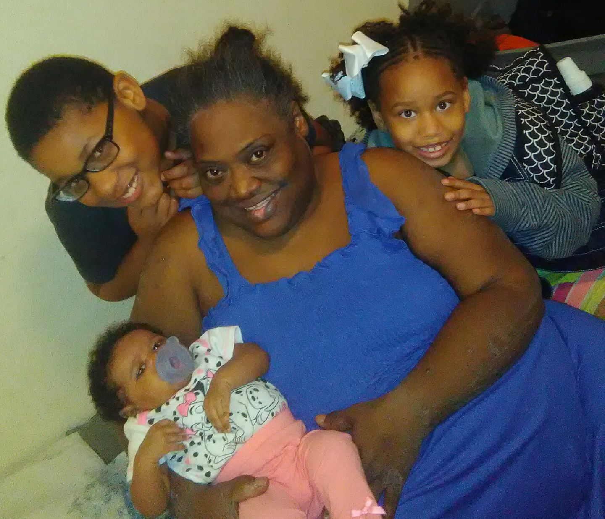
Roxanne Glapion
Notes:
Questions for Roxanne
How do you start a conversation about Healthcare?
What part of your story do you share to emphasis how important healthcare access is?
What is difficult to talk about and how do you move beyond that?
What is your “ask” for folks?
What would you add especially when you are talking to elected officials

Slide 23
Notes:
Why it is important to talk about Healthcare this election year?

Slide 24
So what does it mean to be a #HealthcareVoter?
Pay attention to what the presidential candidates are saying and what's included in their health care platforms!
Look at the records of your members of Congress. What have they said, done, and voted for, eg. on repeal of the Affordable Care Act?
Look at your state elected officials (legislators and Governor). How have they handled issues such as Medicaid expansion and Medicaid work requirements so far?
Attend Congressional candidate forums and ask questions designed to get them on record about their commitments to healthcare. Do the same with relevant questions for state level candidates (these will be different questions)

Slide 25
What does it mean to be a #HealthCareVoter? Part 2
Commit to show up and vote in 2020!
Commit to reach out to 20 people in your personal network between now and November to talk to them about voting. Get them to sign the pledge to be a Health Care Voter!

Slide 26
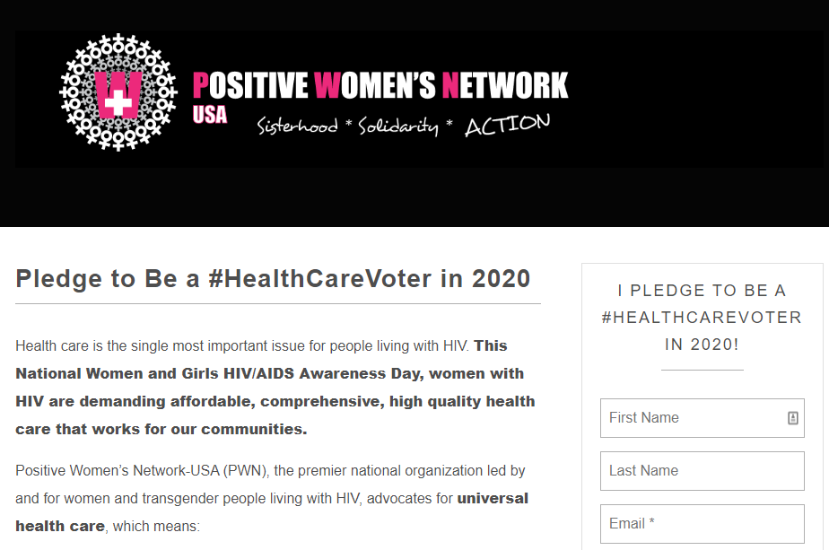
Sign Me Up to Be a #HealthCareVoter
Or bit.ly/healthcarevote-pledge
Notes:
And our ask because we should always have a way for people to participate

Slide 27
???

Slide 28
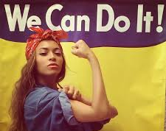
Last Thoughts
“If Health Care for all isn’t on your radar, I need to know why.”
Tana Pradia

Slide 29
Thank you
Please feel free to reach out with any questions
Barb Cardell
PWN USA Training and TA Director
Barb@pwn-usa.org
Tiommi Luckett
Tiommi@pwn-usa.org

