Slide 1
State Legislative Advocacy 101
Breanna Diaz
She/Her
Policy Director, PWN
pwn-usa.org

Slide 2
Objectives
Understand the legislative branch of government.
Understand what is the state legislative process.
How to effectively advocate for issues important to you throughout the legislative process.

Slide 3
About Positive Women’s Network-USA
The only national organization in the U.S. led by and for women and people of trans experience living with HIV.
Founded in 2008 by 28 diverse women living with HIV, including women of trans experience.
Today: 3,000 members nationwide.
Chapters in Colorado, Louisiana, New York, Pennsylvania, South Carolina, Texas.
State leads in another 12 states.
Our mission: To prepare and involve women living with HIV, in all our diversity, including gender identity and sexual orientation, in all levels of policy and decision-making.

Slide 4
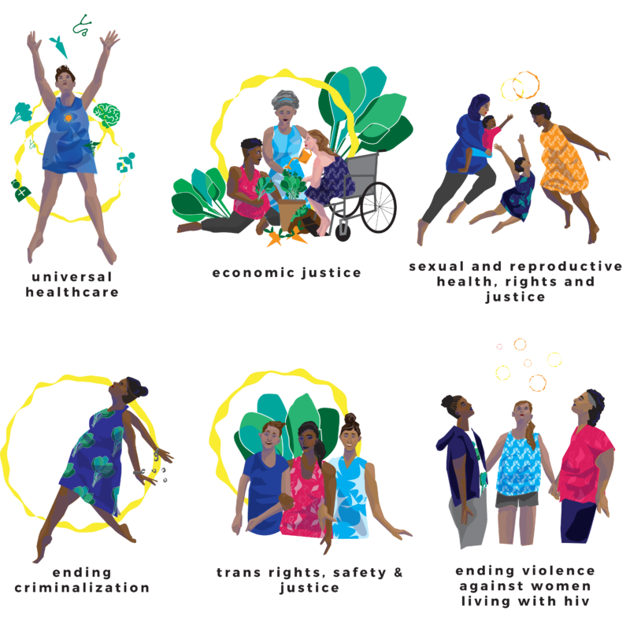
PWN Policy Agenda

Slide 5
Poll Time
Let’s take a poll!
Notes:
Give folks 2 minute to take poll and a minute to go over poll results.

Slide 6
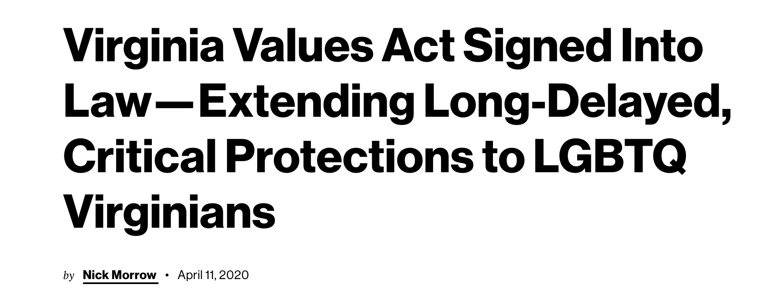
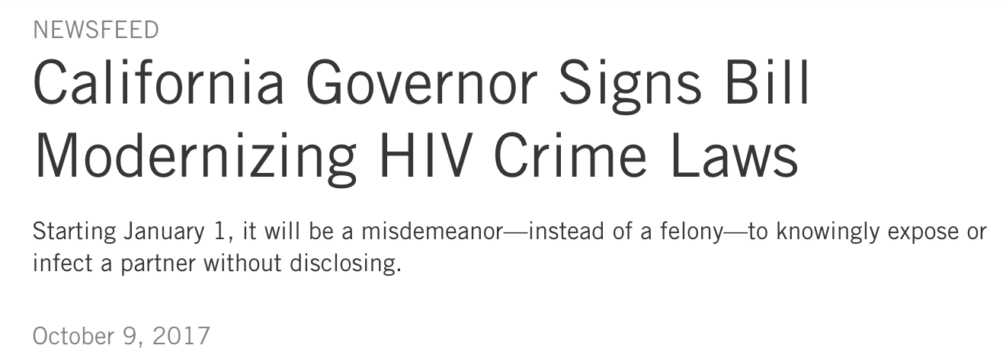
Why State Legislative Advocacy?
Notes:
Discuss types of issues addressed in state legislatures via news article highlights.

Slide 7
Why State Legislative Advocacy?
Not as polarizing as local and federal governing bodies.
Profound impact on the welfare of our communities.
Funding
Legislation

Slide 8
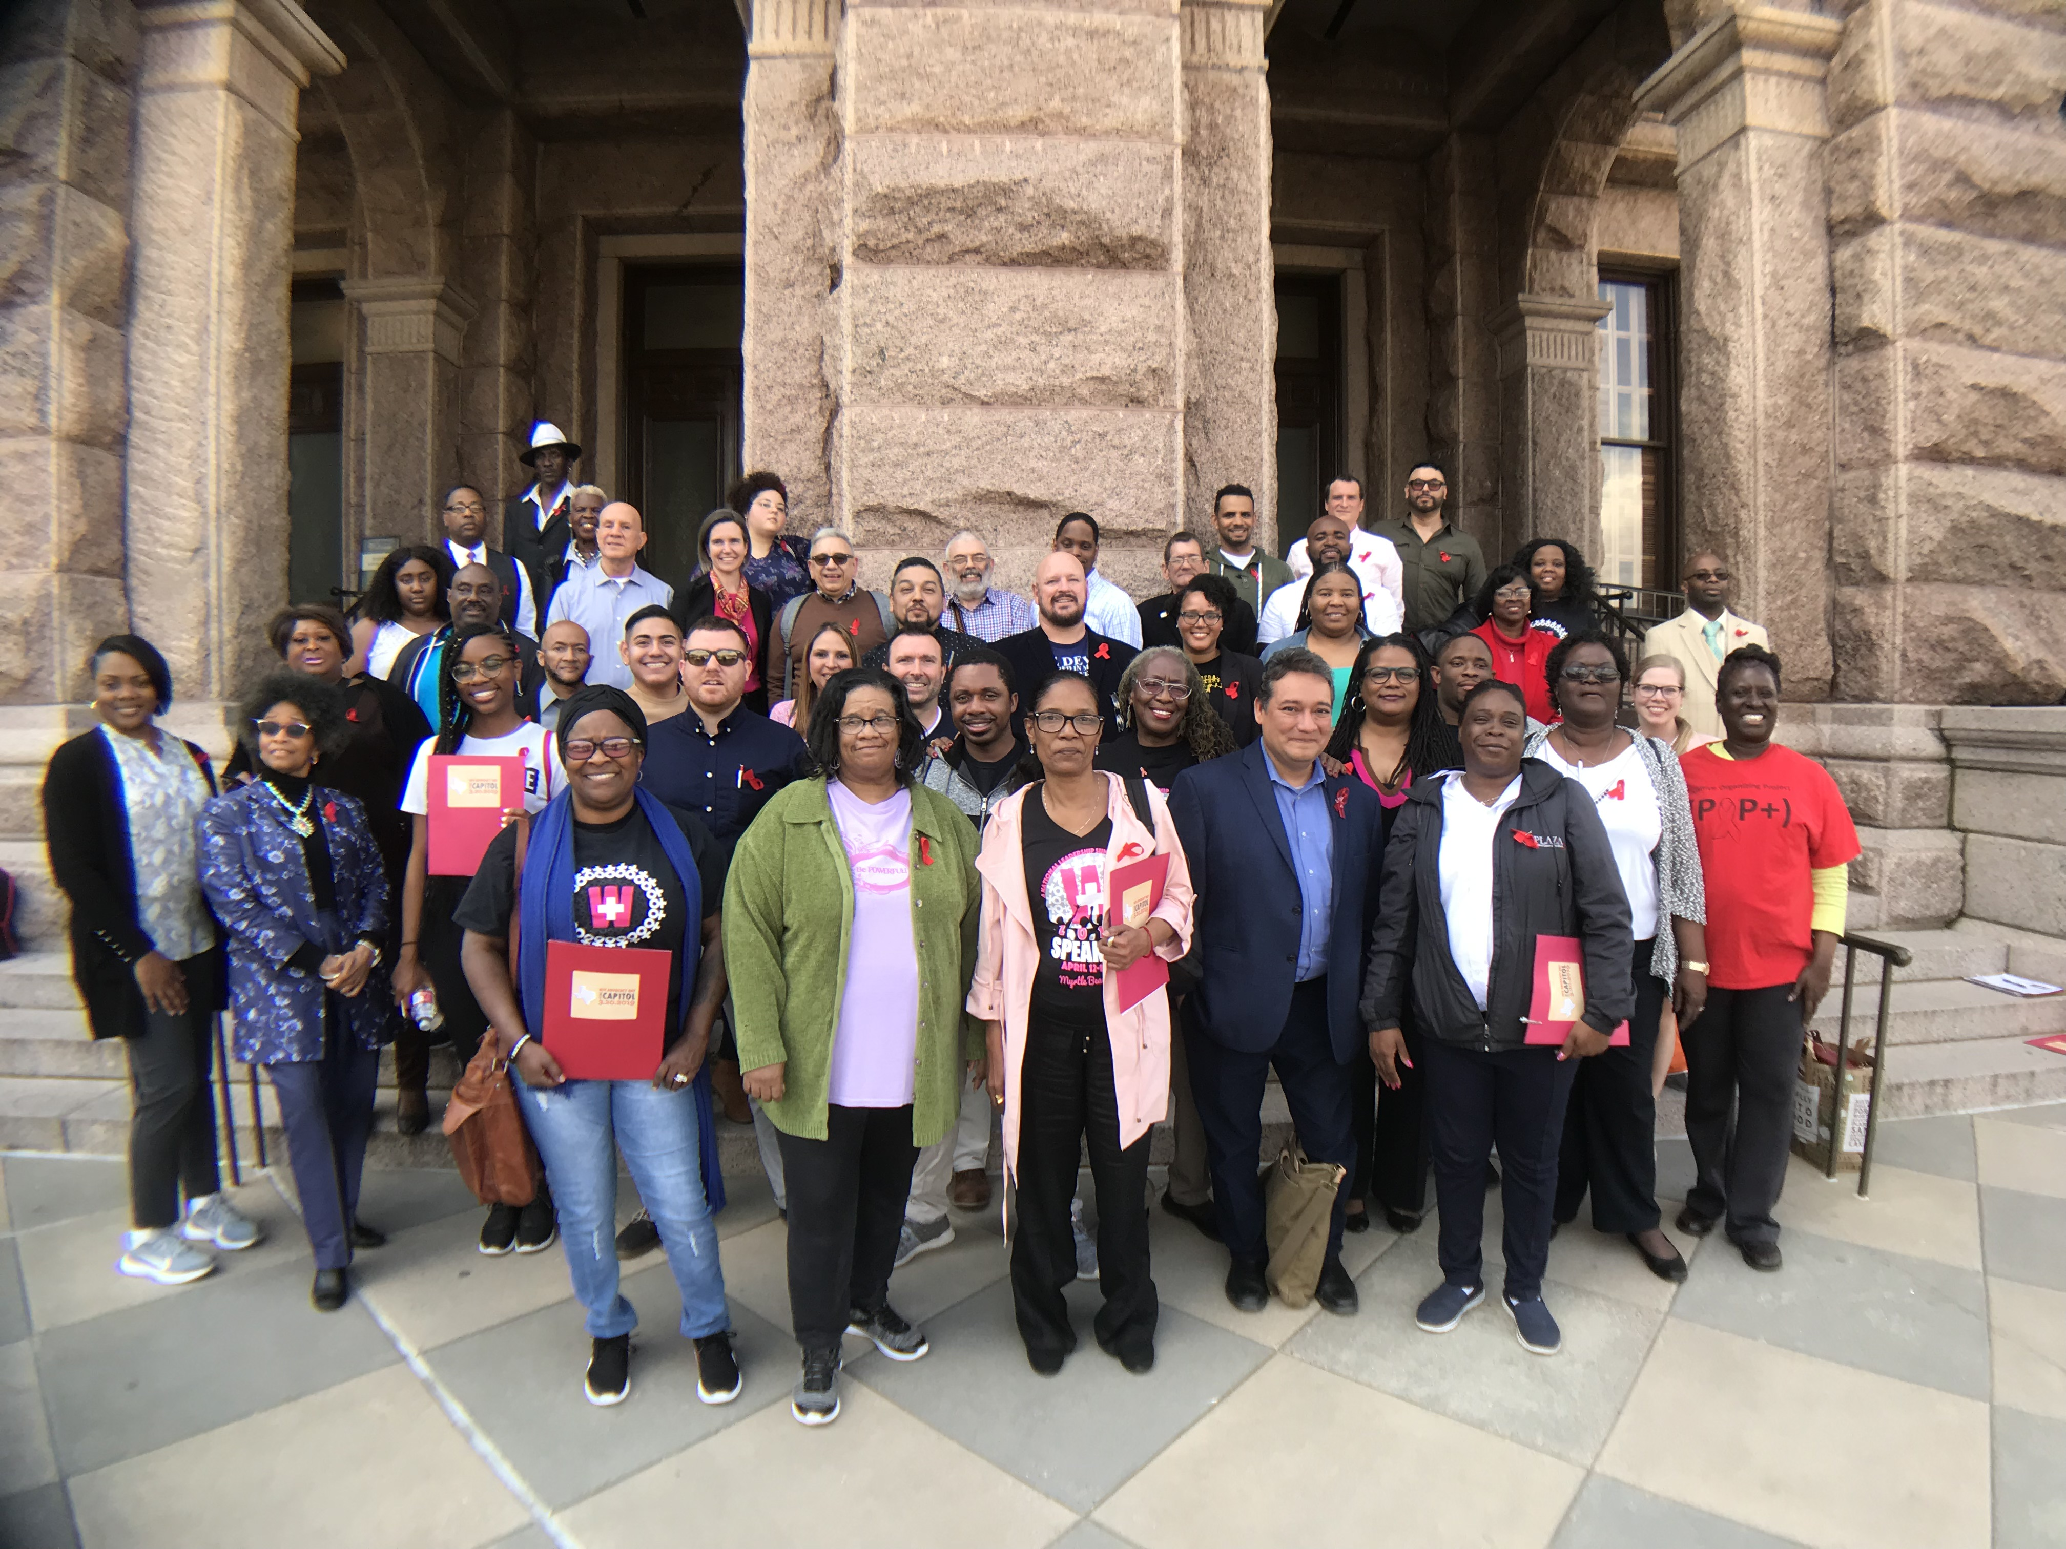
What Can Legislative Advocacy Do?
Change your state’s existing laws.
Pass new state laws.
Give your community a voice.

Slide 9
What Are Legislative Issues?
Reproductive Rights
Voting Rights
LGBTQ Rights
Healthcare
Sex Work, HIV, Drug Use Decriminalization
Funding for programs and services
And so much more!

Slide 10
Notes:
What issues would you like to see addressed in your state's next legislative session?
https://www.polleverywhere.com/free_text_polls/YGkzjGMH5sJT6t8KJBFW7

Slide 11
The Legislative Branch

Slide 12
The Legislative Branch
The state’s law-making body.
Two legislative bodies:
State Senate
State House of Representatives or Delegates
Primary Function:
Representation of constituents.
Creates laws through passage of bills.
Establishes the budget.

Slide 13
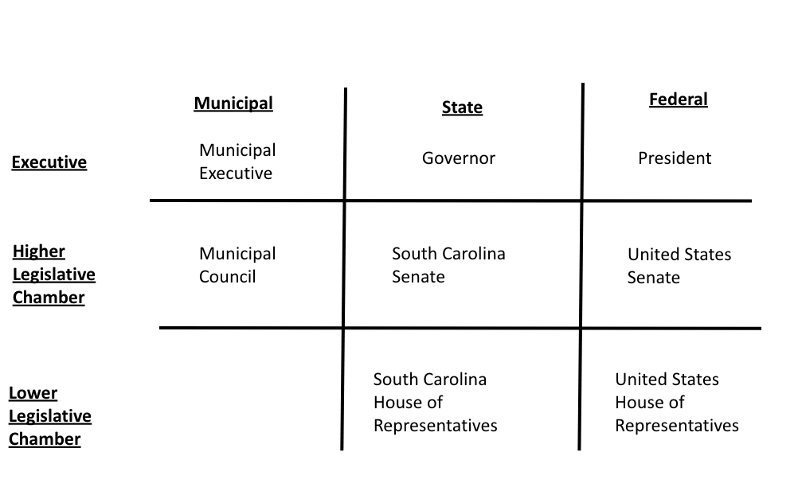
Levels of Representation

Slide 14
The Legislative Process
Co-Sponsor
Concept
Sponsor
Outreach
Committee
Executive
Floor
Law
Notes:
Form coalitions with interested groups such as other GSA’s and school clubs, educators, community groups like teacher’s unions, PTA, nonprofits.
Meet with lawmakers such as senators and representatives.
Write letters to lawmakers urging them to support or oppose bills.
Write to newspapers.
Organize educational events such as rallies or forums.
Testify at hearings.
Informally speak with lawmakers

Slide 15
The Legislative Process: Concept and Sponsor
Issues become concepts which become bills.
Sponsor or “Legislative Champion”
Legislator who introduces a bill.
Can be more than one sponsor for a bill called a “co-sponsor.”
Can become a co-sponsor after a bill is introduced.
Notes:
Link back to word cloud exercise: what issues did folks want to see addressed in their state legislature and how can those issues be turned into concepts.

Slide 16
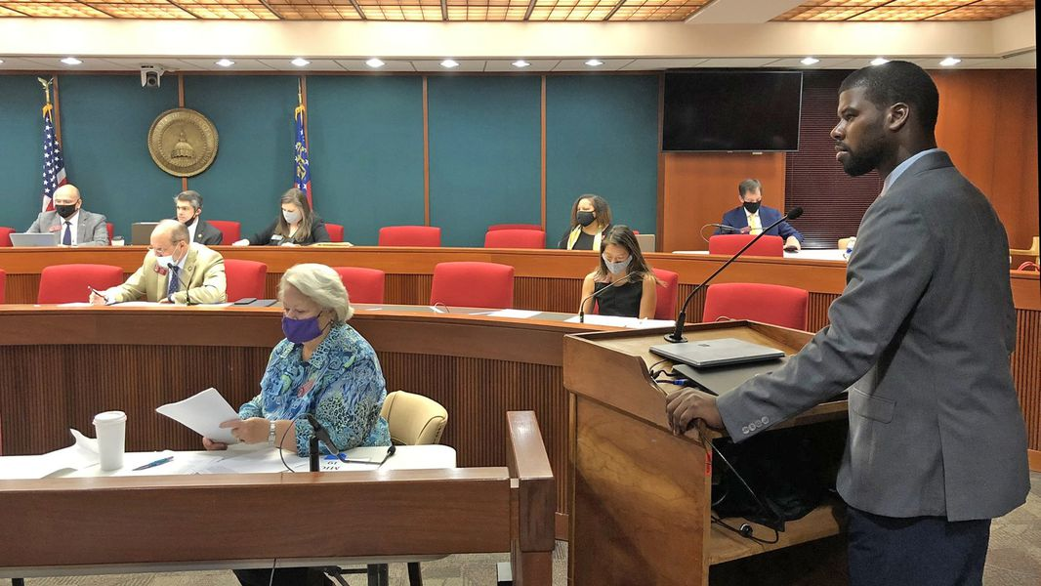
The Legislative Process: Committees
Committees examine policy issues and determine whether a bill will go to the floor for a vote.
Many bills die in committee.
Most of the work to delay or pass a bill happens in committee.
This is where you may provide testimony.

Slide 17
The Legislative Process: Floor and Law
The Floor: Where the votes on a bill happen.
Both the House and Senate must vote in-favor of a bill before it can go to the Governor.
If the House and Senate bills are not identical, the bill cannot move forward until both chambers have voted on the same bill.
Governor signs bill into law.

Slide 18
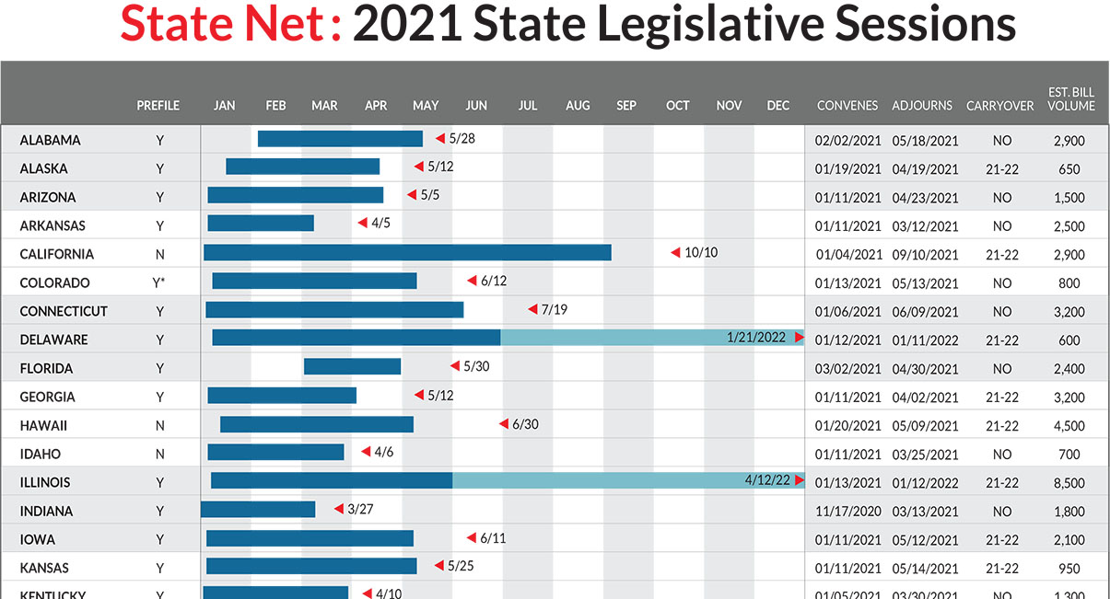
When is your state in session?
Notes:
Show case NCSL site: https://www.ncsl.org/research/about-state-legislatures/2021-state-legislative-session-calendar.aspx

Slide 19
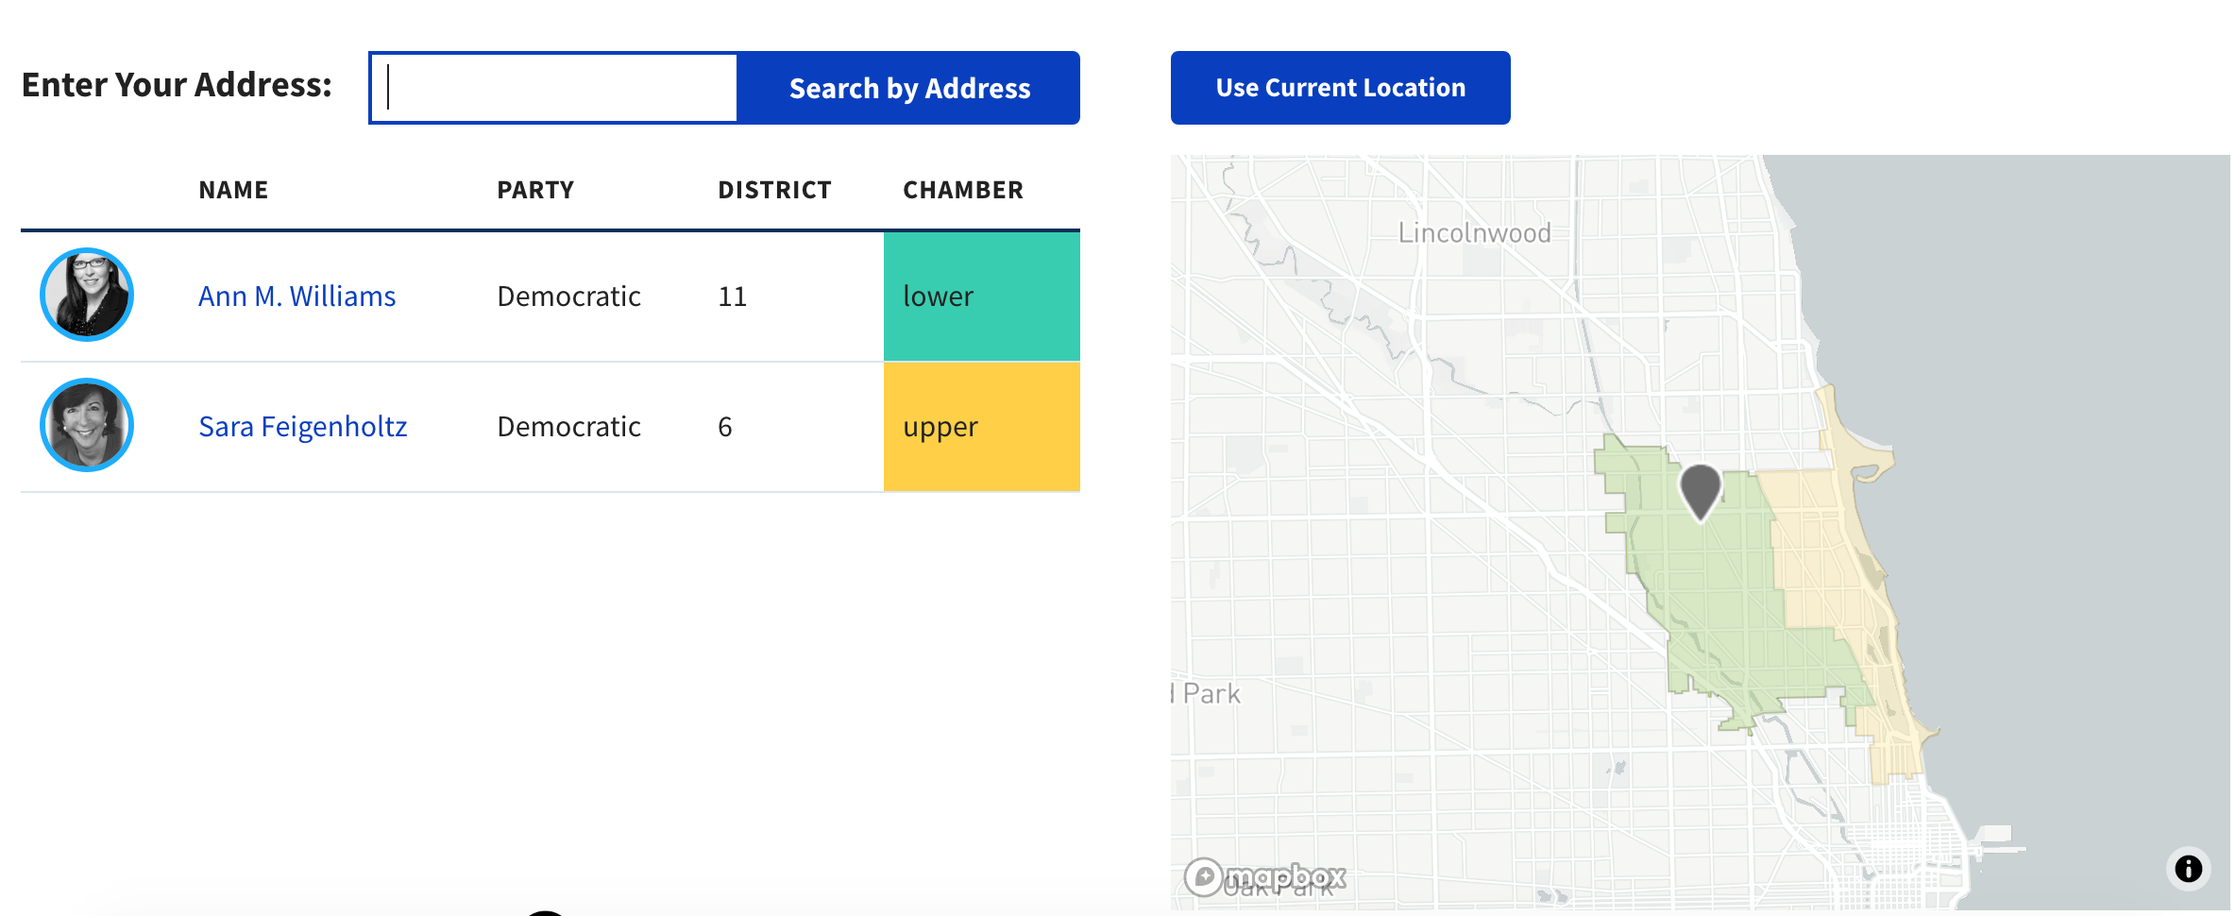
Who is your representative and senator?
Notes:
Showcase: https://openstates.org/

Slide 20
Legislative Advocacy

Slide 21
Why Should You Be A Legislative Advocate?
You are the subject matter experts!
As a person living with HIV.
As a person providing services to people living with HIV.
As a community advocate.
Your lived experience provides perspective and impact far beyond what only data can provide.
Lawmakers need the human story and face to understand how laws and policies impact communities.
Notes:
One of the most important aspects of our system of government is that it is representative—those who make our laws represent us. But how can they represent us unless we let them know what we are thinking? We can and should remind leaders of their responsibilities to their constituents and offer them constructive ideas. If we do, we can bring about policy changes. It’s not a difficult thing to do, and it doesn’t take a lot of time. It just takes the will to act and speak out for yourself and on behalf of those who may not be able to speak for themselves.

Slide 22
Types of Advocacy
Direct Outreach
Coalitions
Engage with the Legislative Process
Develop Tools

Slide 23
Types of Advocacy: Direct Outreach
Develop relationship with legislator(s) and other stakeholders.
Reach out to your legislator(s) via email or in-person (when safe!).
Reach out to partner organizations, let them know what issues are important to you that they should address.

Slide 24
Types of Advocacy: Coalitions
Form or join a coalition.
Issue-specific
Meaningful involvement of people living with HIV (MIPA)
Multiple ways to be involved:
Leader, member, consultant, or volunteer.

Slide 25
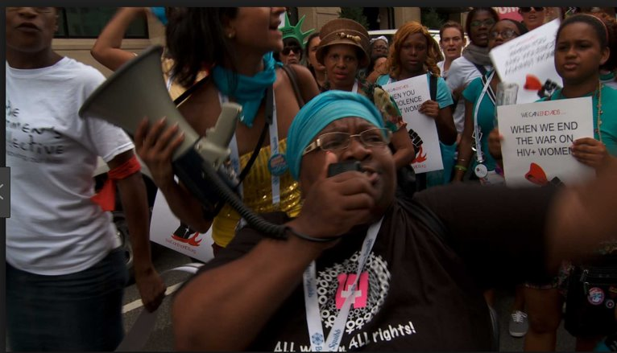
Types of Advocacy: Engage with the Legislative Process
Attend hearings—virtually or in-person (if safe)
Provide testimony
Oral testimony
Written testimony
Attend an advocacy day
Participate in a planned action:
Phone Zaps
Tweets

Slide 26
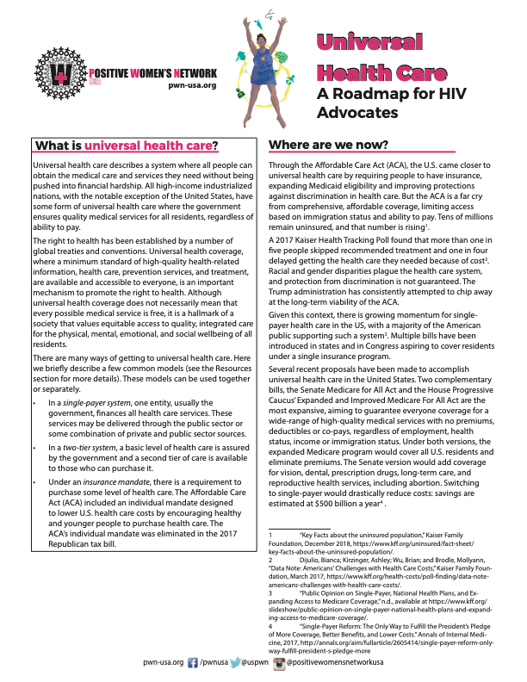
Types of Advocacy: Develop Tools
Develop and provide tools:
One pagers or factsheets
Petitions
Sign-on letter
Op-eds, journals and newspaper articles

Slide 27
PWN Advocacy in Action
Notes:
Brief case examples of PWN members doing state lege work; sharing their success.

Slide 28
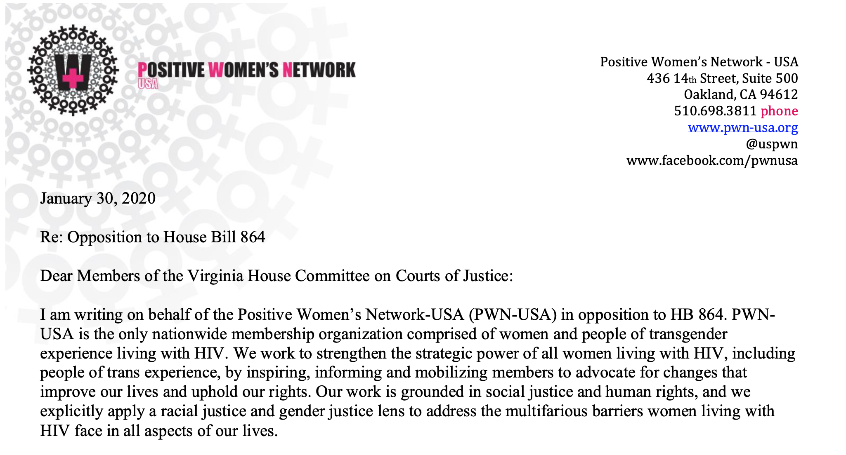
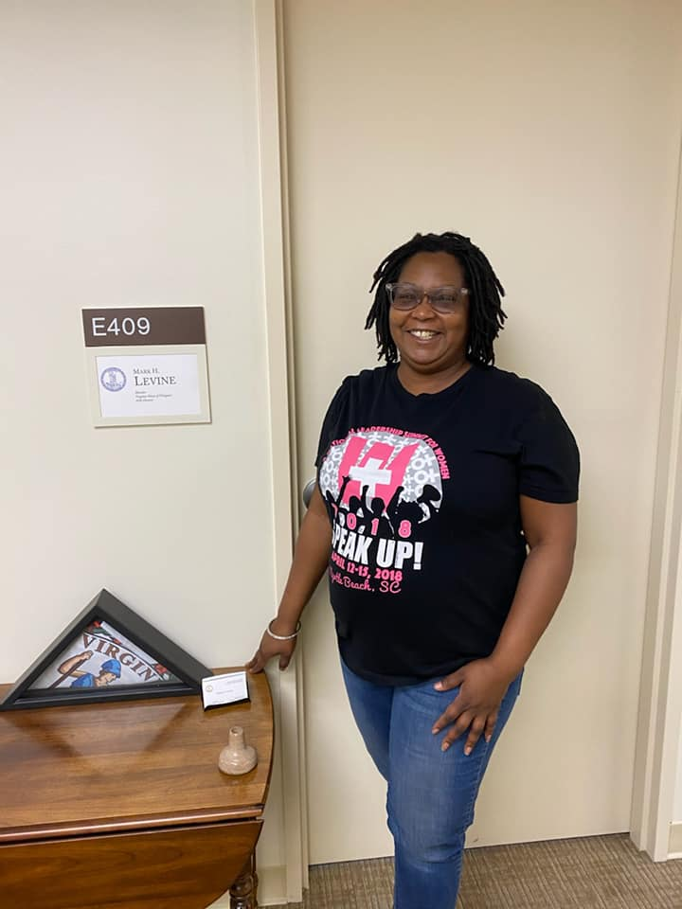
Virginia HIV Justice Coalition
ECHO-VA identified and responded to bad HIV criminalization bill.
Provided in-person and written testimony.
Formed larger coalition w/ partner orgs.
Introducing new community-led bill.
Notes:
Discuss Virginia crim bill in 2020 VA session as an example of providing testimony and forming a coalition to introduce a community informed and led bill.

Slide 29
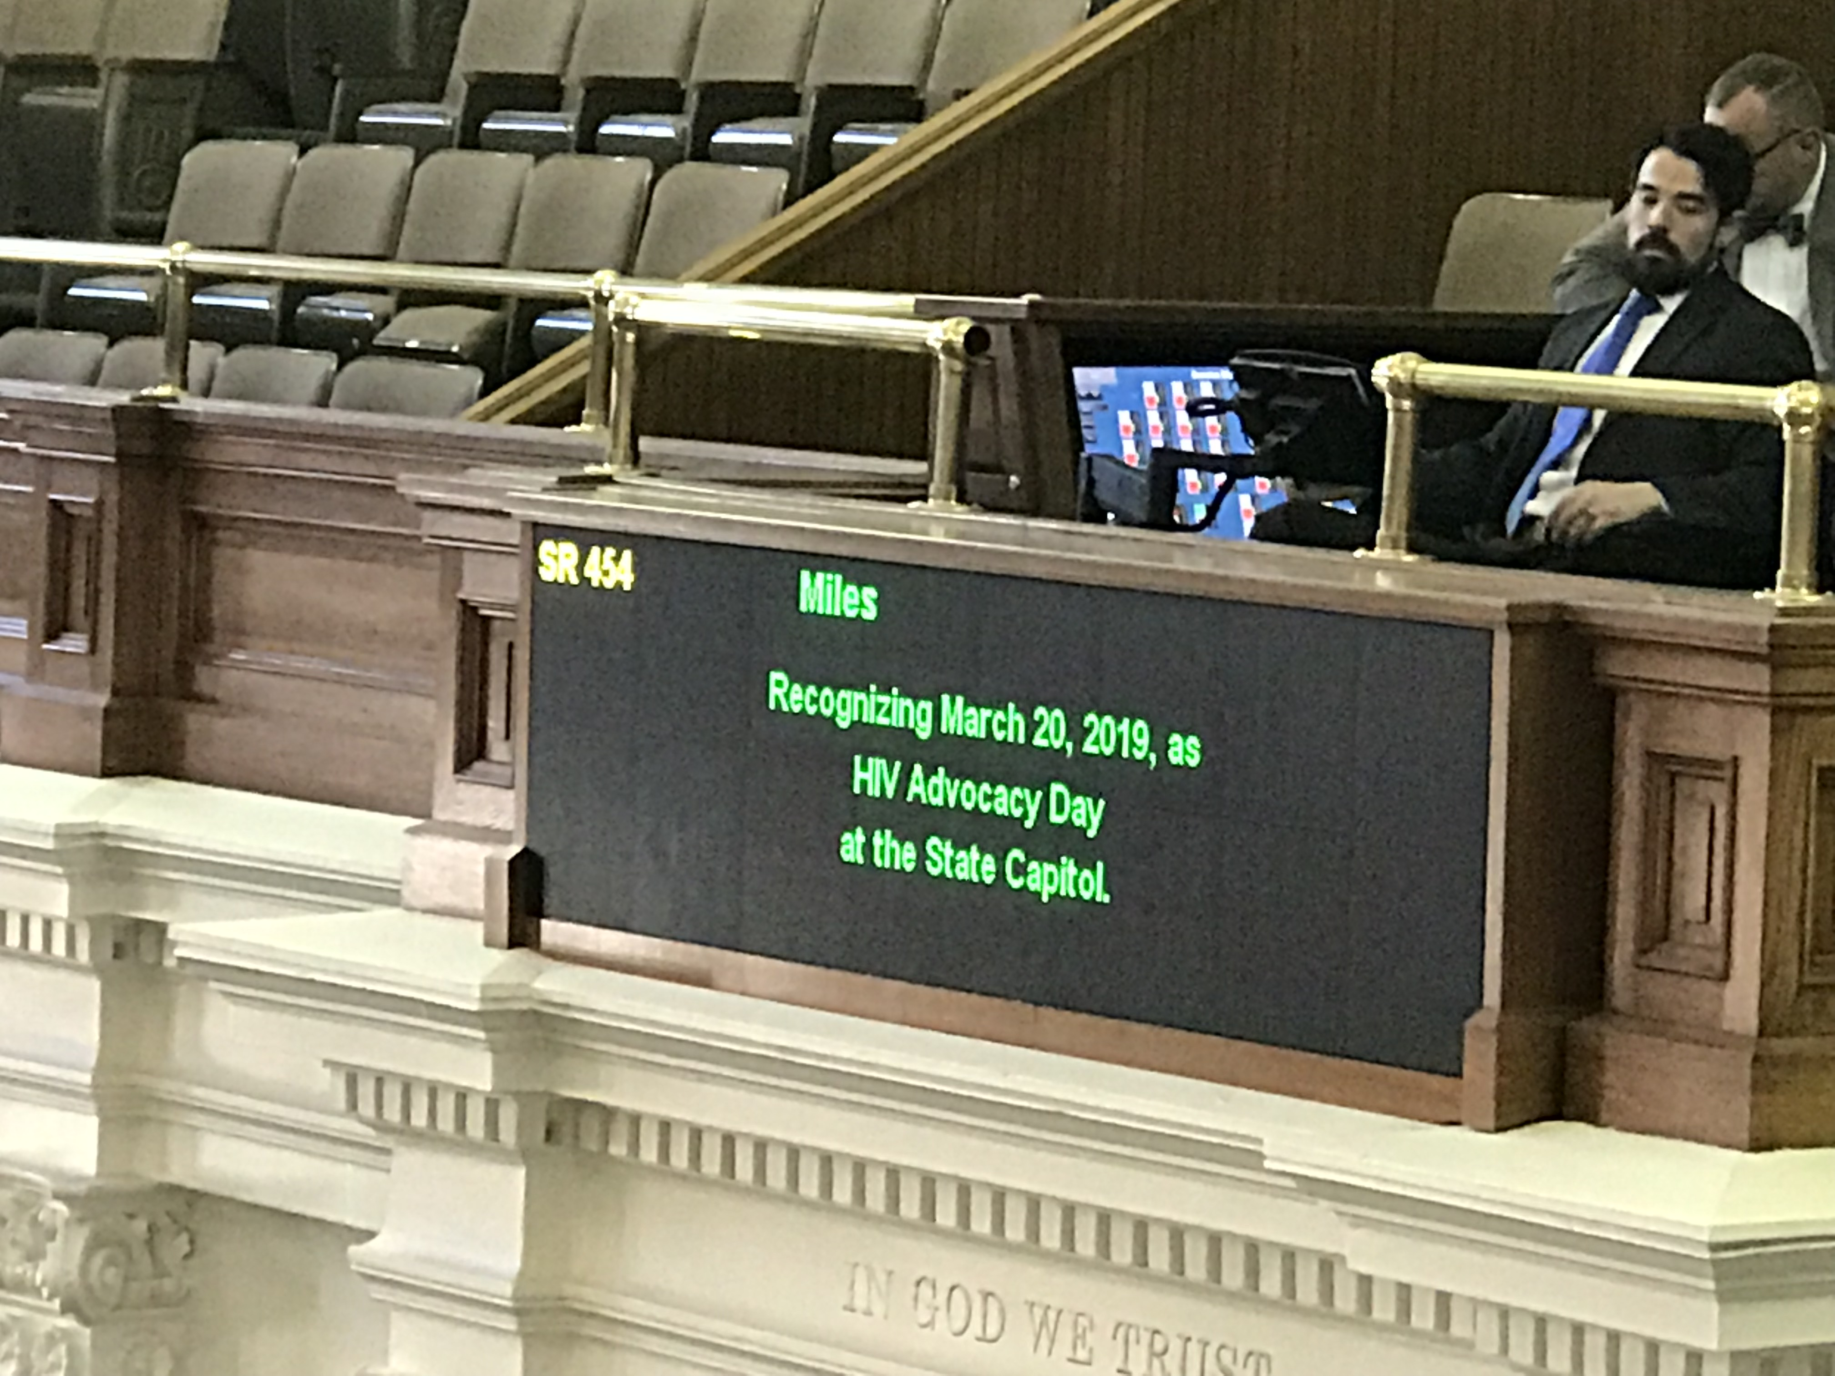
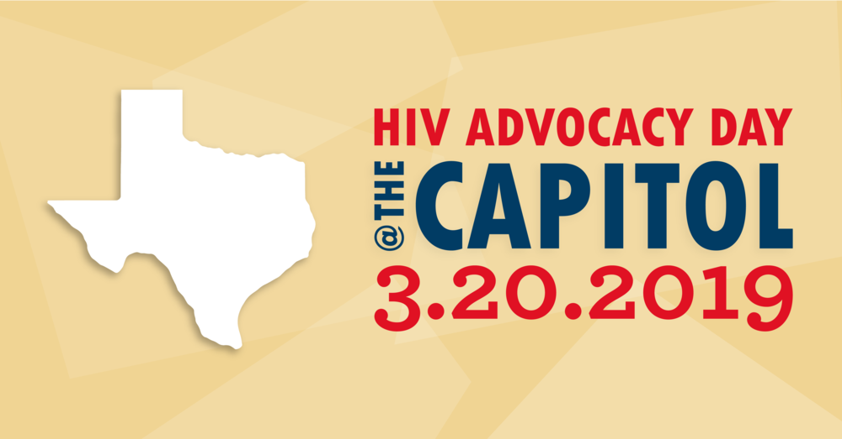
Texas Strike Force: HIV Advocacy Day
HIV Advocacy Day held on March 20, 2019.
65 attendees.
Attendees from Houston, Dallas, San Antonio, Rosenberg, Austin, and Beaumont.
41 visits with legislators.
Recognized on the TX Senate floor by Senator Boris Miles (D-TX13).
Notes:
Discuss the session-length advocacy work by the TX strike force-–highlighting advocacy day as a form of lege advocacy.

Slide 30
Resources
Open States: Find Your Legislators, https://openstates.org/
PWN-USA Policy Agenda, https://www.pwn-usa.org/issues/policy-agenda/
PWN-USA How to Advocacy Guide for People living with HIV, https://www.pwn-usa.org/training/advocacy-guide/
Sero Project Bill Tracker, https://www.seroproject.com/state-coalition-bill-watch/

Slide 31
Questions?
Breanna Diaz, Breanna@pwn-usa.org

Slide 32
State Legislative Advocacy Training Series
Issue Based Advocacy, Wednesday, Dec. 16
Building Support for Your Issue Through Effective Messaging, Wednesday, Jan. 13
Community Mobilization, Wednesday, Feb. 17

Slide 33
Evaluation Form
Please fill out our evaluation form!
Shared in the Chat Box
Shared with attendees via email

